Slide 1
Water Supply Planning:
Current and Future Water Demands
Water Allocation Committee
Environmental Management Commission
October 9, 2018

Slide 2
Water Supply Planning: Current and Future Water Demands
Statutory Requirements
Water Use Registration
Water Use Management
Water Use Demand and Outlook
Challenges
Q&A

Slide 3
Water Supply Planning
Assures the availability of adequate supplies of good quality water to protect public health and support economic growth.
Water supply planning and management requires an understanding of both available water resources (sources of supplies) and demands being placed on those resources.

Slide 4
Water Use Permitting & Registration
No State-wide Water Use Permitting Program
Limited Regional Permitting
Central Coastal Plain Capacity Use Area (CCPCUA)
Eno River Management (Voluntary)
Only State-wide Water Use Registration
Local Water Supply Plan (LWSP)
Water Withdrawal Registration (WWR)

Slide 5
Local Water Supply Planning
Law was established in 1989 by §143-355(l)
Requires all unit of local governments and large community water systems to prepare a Local Water Supply Plan (LWSP)
Applies to systems with >1000 connections or >3000 people
A LWSP is an assessment of a water system's current and future water needs and its ability to meet those needs
A LWSP contains a systems water shortage response plan, water efficiency plan and surface water transfer worksheets (if needed)

Slide 6
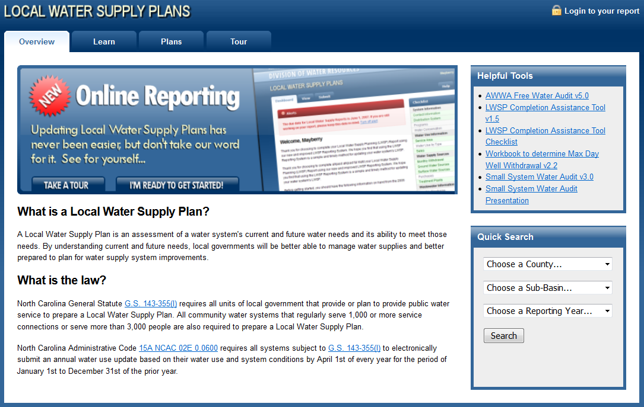
LWSP Components
Water System Information
Contact Information
Distribution Data
Maintenance
Conservation Programs
Water Use
Service area
Water Use by Type
Water Sales & Purchases
Ground Water Sources
Surface Water Sources
Surface Water Transfers
Water Treatment Facilities
Wastewater Information
System Planning
50-Year Projections
Future Sale and Purchase Contracts
Future Supply Sources
Plan for Meeting Future Water Supply Needs

Slide 7
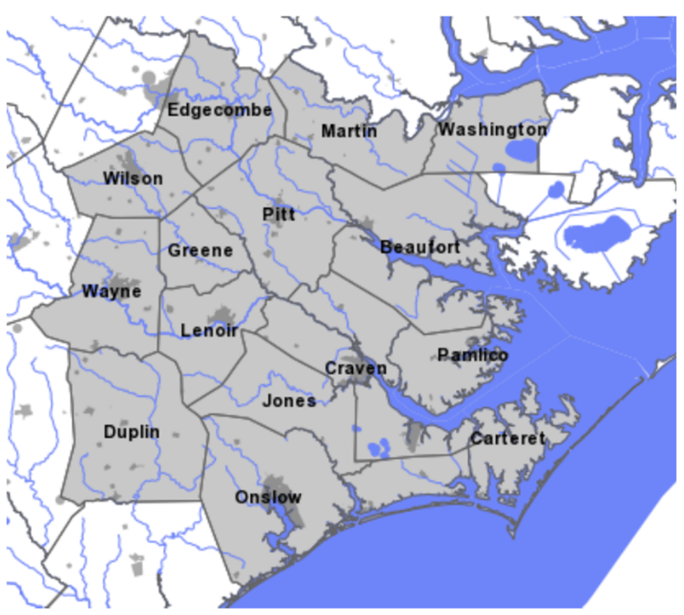
Central Coastal Plain CUA
Covers 15 eastern Counties in NC
Intended to prevent “de-watering” & salt water encroachment in aquifer
Registration required for withdrawals > 10,000 gpd
Permit required for withdrawals > 100,000 gpd
300+ active permits at this time
Phased reduction of withdrawals also mandated
2018 begins phase 3 reductions of 30-75% from initial base rate
Department of Environmental Quality

Slide 8
Water Withdrawal Registration Program
Requirements:
G.S. 143-215.22H was established in 1991
Agricultural users > 1,000,000 gallons any single day
Non-agricultural users > 100,000 gallons any single day
Registered water users have until April 1st to report water usage for the previous year
Completing the Agricultural Water Use Survey does not fulfill this reporting requirement > 1 mgd

Slide 9
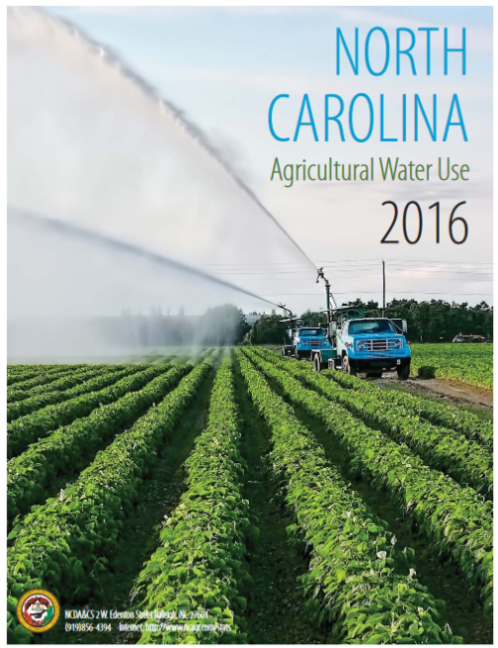
Agricultural Water Use Survey
Session Law 2008-143
Prior to 2008, no official data set to represent agriculture existed
Required NCDACS – ASD to collect annual information
Required for entities that withdraw 10,000 gpd or more in any one day
Surveys remain confidential & combined with other reports to produce totals
7th statewide survey
Data from 2016 NC Agricultural Water Use Survey, NCDACS-ASD

Slide 10
Water Use Management
Water Users
Agricultural
Domestic
Energy
Industrial
Mining
Public Water Supply Systems
Recreational (Golf, Snow making, Water sports, etc.)
Aquatic Wildlife, Habitat, and Associated Floodplain
Future Water Users

Slide 11
Drought Planning
Minimize harmful impacts of drought and water supply emergencies on public health and safety, environmental quality, and the economy.
Establish minimum standards and practices for:
water shortage response planning,
water use reporting,
water conservation, and
water reuse during droughts and water supply emergencies.
Rules governing water use during droughts and water emergencies
New Water Withdrawal Reporting

Slide 12
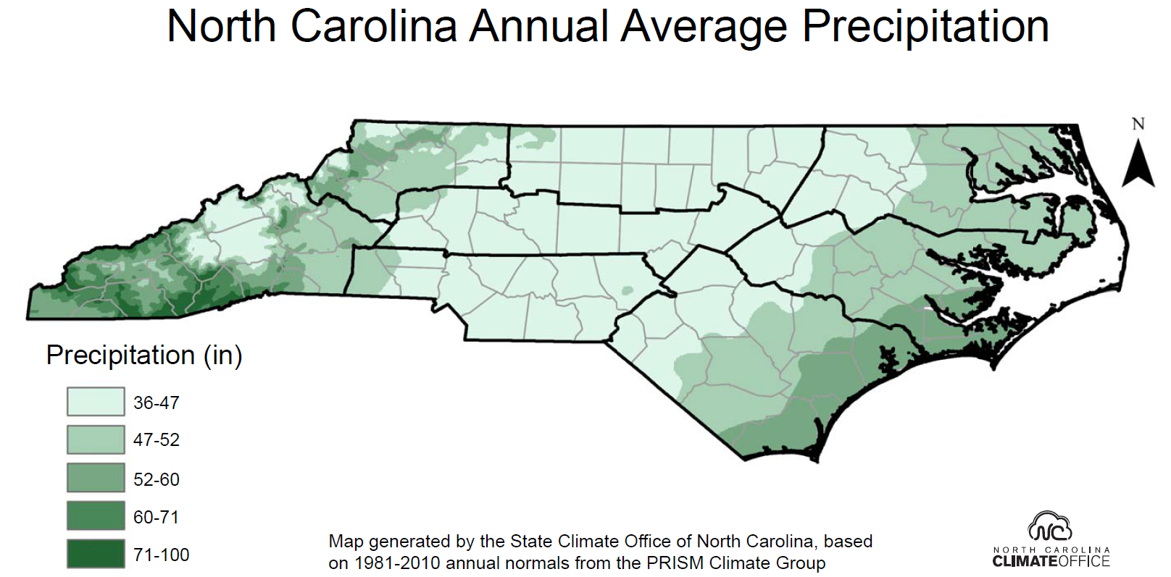
Water Resources Condition

Slide 13
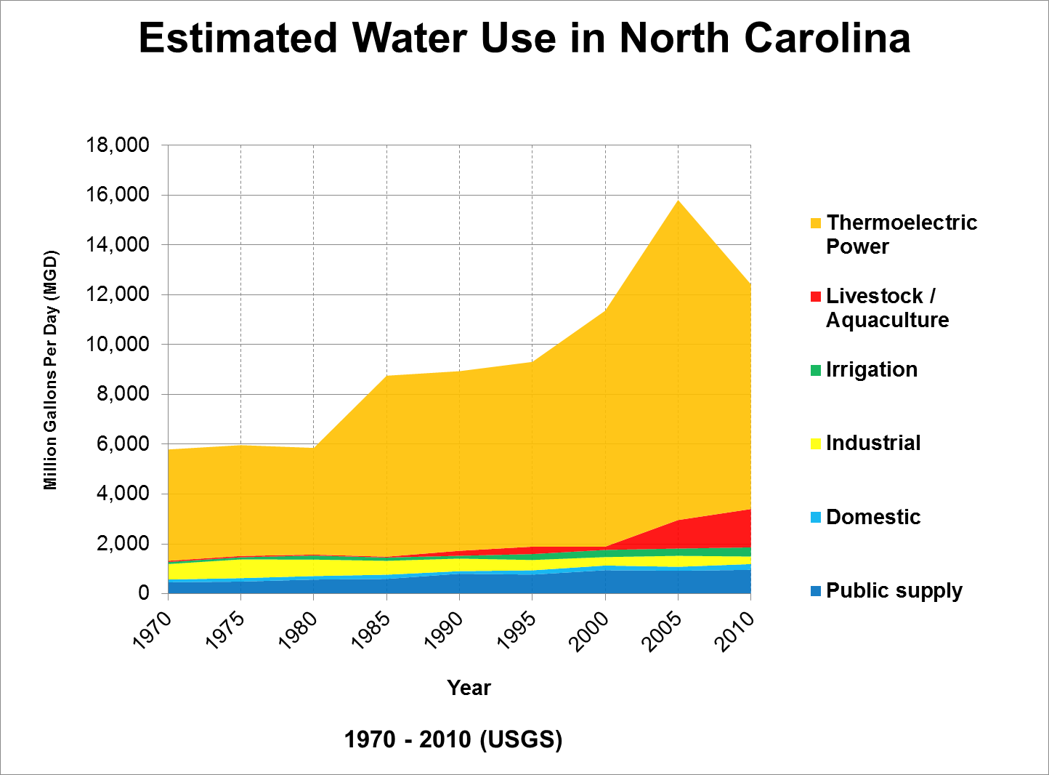
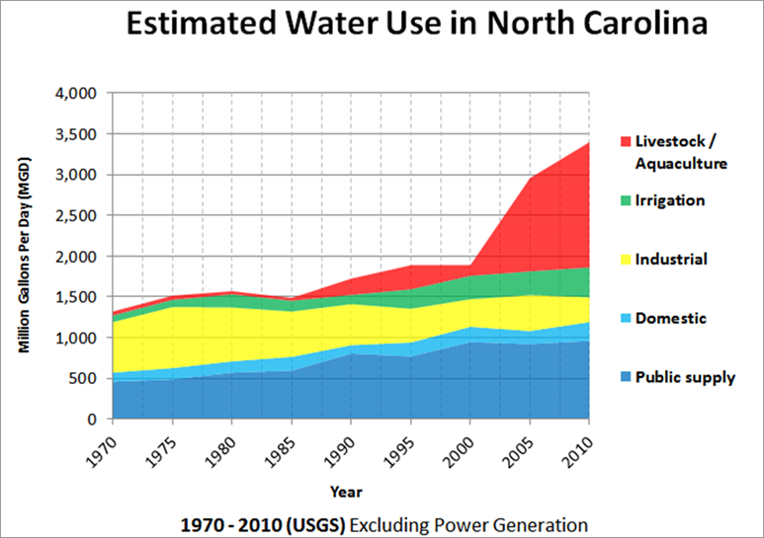
Water Resources Demand

Slide 14
Water Resources Outlook

Slide 15
Challenges to NC Water Supply Planning
NC Water Law – Riparian Rights State
No comprehensive plan for water quantity management in NC
No federal oversight of / nor federal requirements for water quantity management
No permitting program
Pros
Less government regulation & permitting
Equal right to the water for all “reasonable use”
Cons
No plan to ensure availability of water for future water supply, agriculture, industry, continued economic growth, & ecological health on NC’s water bodies
Courts would have to make the determination of reasonable use

Slide 16
Challenges to NC Water Supply Planning
Lack the ability to plan and manage all water uses
Water use must be reported (especially large users)
Need better agricultural data
Need to consider Ecological flows (Instream uses)
“Proper” documentation of water users’ needs
Growth and projections
Economical development
Coordination between other water users

Slide 17
Challenges to NC Water Supply Planning
Need more monitoring of ground and surface water sources
Difficult to quantify availability of water supply
How much surface water will be available?
How much ground water will be available?
Difficult to develop and utilize surface water sources
Onstream & offstream reservoirs, quarries, etc.
Some interbasin transfer issues may arise
Aging infrastructure (Lack of funds for maintenance and planning)
We must…

Slide 18
Manage our limited water supply for sustainability…

Slide 19
Questions?
Linwood Peele, Supervisor
Water Supply Planning Branch
Division of Water Resources
Linwood.Peele@ncdenr.gov
919-707-9024

Slide 20
Department of Environmental Quality

